Slide 1
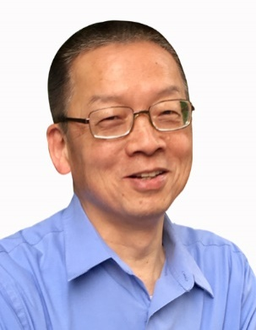
T. T. Chen
Operating Partner Taplow Management Consulting
T. T. Chen is a free-lance Operating Partner for private equity firms and multinationals. He specializes in interim general management and executive coaching. He has completed 11interim GM/CEO assignments for portfolio companies for EQT Partners, CITIC Capital Partners and Blue Point Capital Partners, as well as for western MNCs and SMEs.He has coached over 60 executives in Ford, TRW Automotive (Zf), Fonterra, Tyco Electronics, Associated British Food, GSK, Pfizer, Givaudan and Schaeffler,
T. T. also has over 25 years of operations and technical experience in multinational companies, including 12 years of start-up and building industrial and consumer businesses for Avery Dennison in China, Japan and Southeast Asia.
T. T. is Co-Chair of Manufacturers Business Council of American Chamber of Commerce in Shanghai. T. T. is also Shanghai Chapter Lead for Asia Transformation and Turnaround Association.

Slide 2
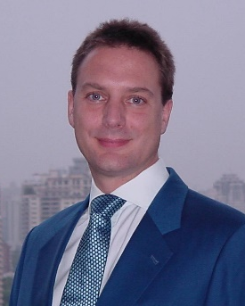
James Greener
Director
Asia Transformation and Turnaround Association
James Greener was born and educated in Britain. He worked for 8 years in Asian capital markets in London before moving to China in 1994.
For over 20 years he has focusedon the integration and transformation of industrial and automotive enterprises.From 1999 to 2003 he worked on fifteen restructuring, integration and transformation projects in China with PwC ranging from industrial state enterprises to a private equity backed IT systems integrator. He then ranBMW Supplier Development in Greater China for five years and from 2010 to 2012 Daimler Van Interior at Fujian Benz. He has led over 50 automotive supplier development programsas a VDA 6.3 Process Auditor. He also delivers industrial transformation projects in other industries, recent examples being pumps, chemicals and refrigerators. Digital transformation is an ongoing theme, especially the deployment of blockchain-enabled smart contracts in supply chain finance and value network integration.
James is currently VP Operations of Kelvion Heat Exchangers China, leading its turnaround after years of decline and its transformation into an innovative industrial leader.
He lives in Shanghai with his wife and two children. James speaks Mandarin and German, holds an MBA degree focused on Chinese state-owned enterprise restructuring,formerly chaired the Asia Transformation and Turnaround Associationand writes on the birth of the Industrial Revolution.

Slide 3
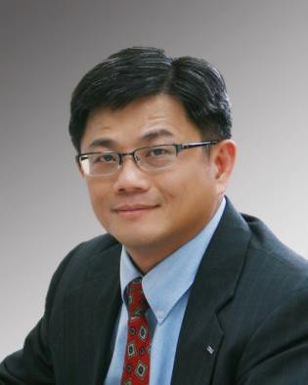
Ching-Ming " Jimmy " Chen
President
CAROTA
Dr. Jimmy Chen is a versatile, highly driven Fortune 500 executive with over 28 years of extensive experience in the global automotive, New Energy Electric Vehicle (EV), &Telematic/Internet of Vehicle(IOV)/Over-the-Air (OTA) Technology areas. A strategic problem-solver and hands-on leader.
Jimmy has proven track record of driving significant revenue growth in highly competitive business markets, operations excellent/Lean implementation, turn-around Joint Venture (JV) operations, and leading Chinese company to go globalization.Jimmy had international work experience in USA, Mexico, Germany, Japan, Korea, India, Thailand, & Greater China region.
Jimmy is currently President, Carota Technology Corp, focusing on telematics/internet of vehicle (IOV) and is also a Senior Advisor at InterChina consulting. Jimmy has served as CEO at Shenzhen Senior Technology Material Co., Ltd. (300568.SZ), and Globe Group Co. (JV of China Greenworks tool Ltd. and Germany Stihl Co.), as COO of Minth Group Ltd. (0425.HK), and as President, greater China region, Autoliv. Jimmy has also served in Senior Executive position at Owens Corning, Danaher, ZF-TRW, Delphi Automotive, and as Assistant Professor/Chairman of Computer Integrated Manufacturing Systems (CIMs) Programat JSU, USA.

Slide 4
Chris R. Deans
Executive Coach and Consultant
In Operations and Global Supply Chain
With more than thirty years’ experience in lean manufacturing and global supply chain management, Chris now provides executive coaching and operational excellence consulting for multi-national clients such as Jaguar Land Rover, Babcock & Wilcox, GlaxoSmithKline, Starbucks China and Goodyear in Mainland China and Asia-Pacific. He has served as an interim and full-time factory manager and GM for SME manufacturers in China. As the LeanTech International Consulting (Nanjing) President, Chris has provided executive coaching and consulting on many OpEx and supply chain projects. He and his team havedeveloped and led many executive training programs, workshops and seminars. Chris was one of the founders of the China Centre for Operational Excellence that establishedthe Shingo Institute’s first educational partner in China and led to China’s first company to successfullyreceive Shingo recognition.
Chris publishes blogs on coaching, high-performance teams and executive leadership. He is a member of the ICF – International Coaching Federation and ATTA, the Asia Transformation and Turnaround Association, an organization dedicated to assisting businesses in stress. He hasalso lectured on Leadership, Supply Chain, and Operations for Hult University, Fudan University, Webster University, SKEMA, the University of Northern Iowa and the University of Aberdeen in their Executive MBA programs and has provided 1:1 coaching for MBA and EMBA students of East China Normal University and Tong Ji University.

Slide 5
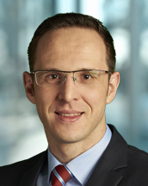
Roger Bischof
Attorney Partner
Bonnard Lawson
Roger is dually-qualified as a lawyer and chartered certified accountant. He is the Chairman of Asia Transformation & Turnaround Association (ATTA) and a member of the board of Swiss Chinese Chamber of Commerce (SwissCham).
Prior to joining Bonnard Lawson as a partner, he was an associate at Baker McKenzie in Singapore and Switzerland as well as a senior consultant corporate finance and senior auditor at big4 accounting firm Deloitte. Roger focuses his practice primarily on cross-border restructurings and insolvencies, market entry advice, foreign investment into China, Chinese outward investment, international business structuring, inbound and outbound M&A, PE and VC.
With his interdisciplinary background and the substantial experience he has gained in both Asia and Europe, Roger has been involved in a number of complex and high-profile distressed transactions and turnarounds.

Slide 6
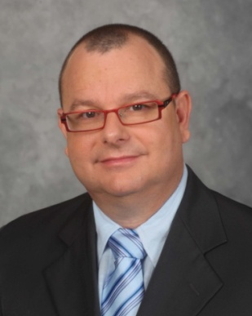
Arie Schreier
General Manager
PTL Group- China
Arie Schreier has over 20 years of management experience with companies and diplomatic missions throughout Asia, Australia and South America. He has spent the last 12 years managing logistics, administration, HR, recruiting, finance, and manufacturing operations for foreign companies in China.
Since 2014 he has been nominated as General Manager of PTL Group - China after fulfilling the role of a COO and VP Sales and Marketing of PTL Group.
Arie has been working with a number of international companies to manage their sales, logistics, and manufacturing operations more successfully in a challenging China market. He was also involved in several Operational Audit as well as Turnaround and transformation projects for foreign Owned entities in China. As one of the founders of the China Industrial Initiative (CI2), he is actively involved in the establishment and management of several manufacturing facilities in the country.
He holds Masters Degrees in Entrepreneurship and Innovation from Swinburne University in Melbourne, Australia, and Public Administration from Tel Aviv University, and a BA in Political Science and International Relations from Tel Aviv University.

